Slide 1
Using Data to help drive home purchasing decisions in Vancouver Canada
By: Taij Taggar

Slide 2
Business Problem
The Vancouver Real Estate market is among the hottest globally. Just last year, Vancouver was ranked the 4th most expensive place to purchase a home in the world.
If Real Estate Agencies were able to utilize data, they could provide their clients with tailored neighbourhoods and areas to choose from.
With home buying being such a large investment in Vancouver, it is important that all stakeholders are utilizing all information available to them.

Slide 3
IDEAL Data SET
Based on the problem above, the following data would be ideal to use in such a project
Neighbourhood names and locations in Vancouver
Crime data for these neighbourhoods in order to advise on safety
Census information for the neighbourhoods to further understand demographics, population and general makeup of the neighbourhoods
Information on amenities in these neighbourhoods to tailor to clients persona

Slide 4
DATA SET USED
For this project, the following sources of data will be used.
Vancouver Police Crime Data: Downloaded as a csv and added to project workbook
2016 census data: Downloaded as a csv and added to project workbook. *Note that in this project only population data is used. Utilization of other census data is beyond the scope of this project
Foursquare API: Used as a source to find information on amenities in surrounding neighbourhoods

Slide 5
METHODOLOGY
Crime Data Wrangling
Merge with Census Data
Defining geographic locations for neighbourhoods
Foursquare API integration to find venues
K-means clustering and Analysis

Slide 6
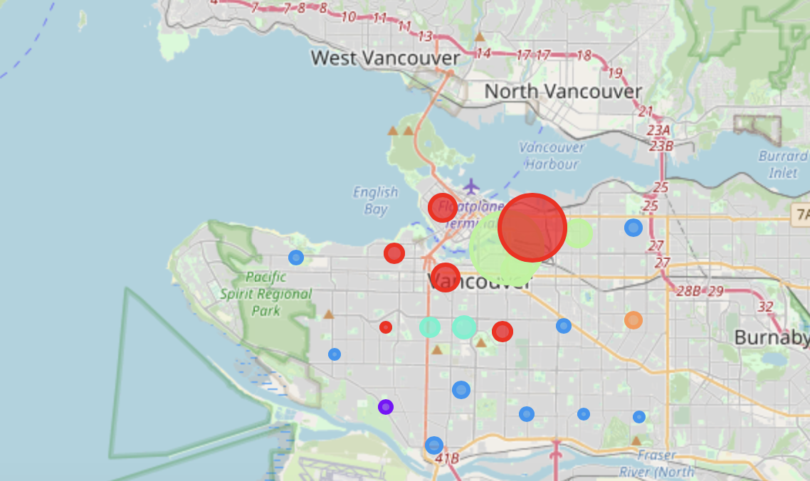
Results

Slide 7
Results cont.
4 groups identified
Group 1: Casual dining – Ideal for families
Group II: Outdoor activities – Ideal for students
Group III: Cultured Cuisine – Ideal for minority groups
Group IV: Entertainment District – Ideal for young adults
Safest neighborhoods in each group
Group 1: Arbutus Ridge
Group II: Kerrisdale
Group III: Killarney
Group IV: Grandview-Woodland

Slide 8
Conclusions & Recommendations
By utilizing crime data and the 4-square API, it is possible to group neighbourhoods utilizing the k-means machine learning algorithm in Vancouver, Canada.
The data and grouping can help home buyers choose what neighbourhoods may be suitable for them to live in Vancouver, Canada
To further refine this model, more data should be used such as
Full utilization of the census data
Home purchase prices per neighbourhood
Further refinement of venue data

